Slide 1
The Idea of a Decentralized Internet
Rahul Jain
Rjain.rahul5@gmail.com

Slide 2
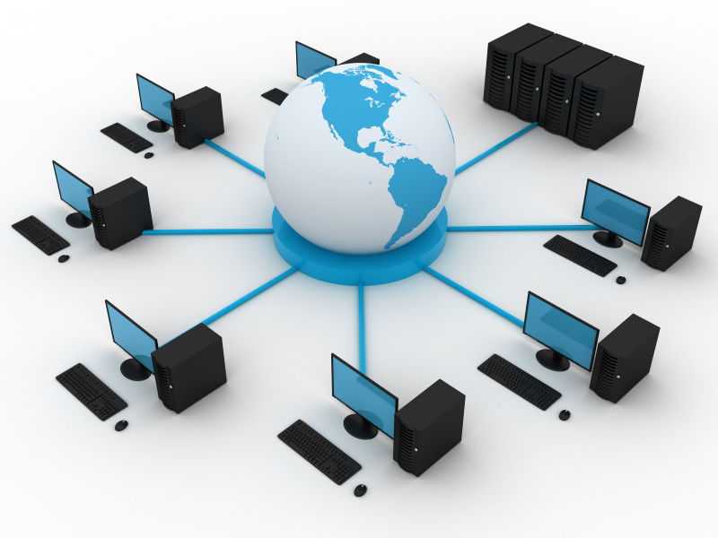
What is Internet?
A Global computer network providing a variety of information and communication facilities, consisting of interconnected networks using standardized communication protocols.

Slide 3
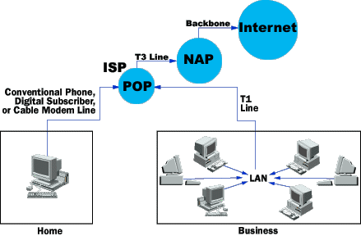
The Current structure of the Internet

Slide 4
What’s wrong with Centralization?
Fake news
State Sponsored Bots
EU Privacy Laws
Algorithmic Biases
Data Commodification
Privacy Breaches

Slide 5
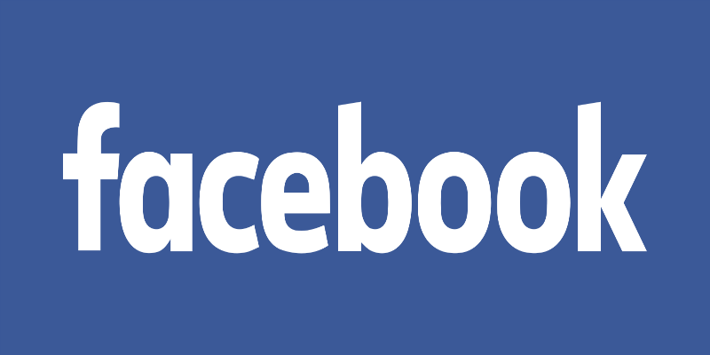

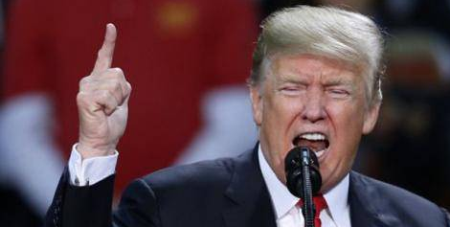
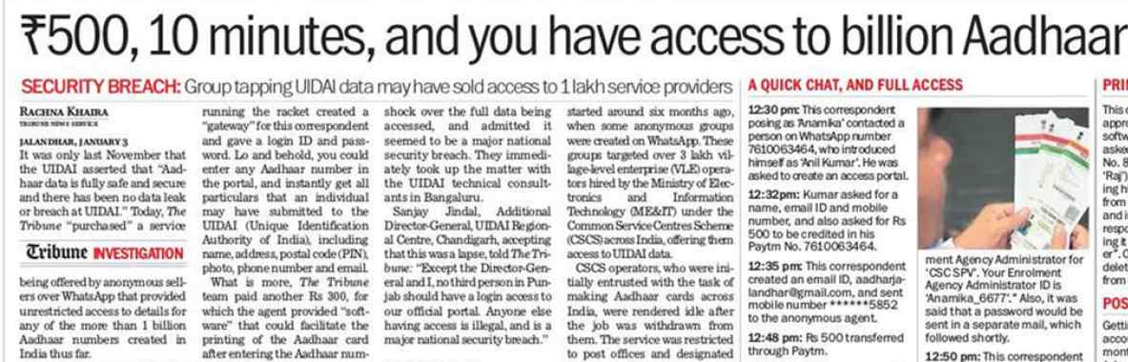
How is Centralization a Threat?

Slide 6
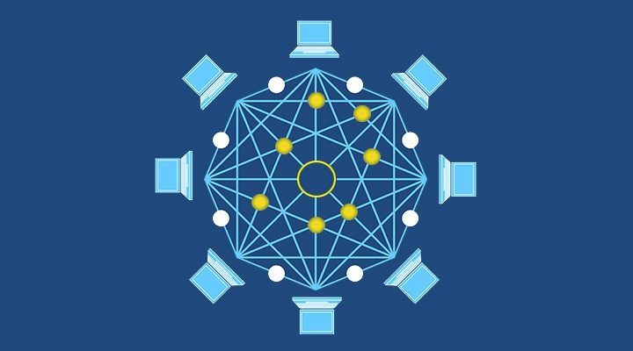
Is there a solution​?
Decentralization

Slide 7
The Idea
The initial structure of the internet was Decentralized.
Commercialization killed Privacy.
Tech Giants forced people to use Centralized Services by leveraging unawareness and simplifying services.
Security over convinience.
Faster, Safer and Community Driven.
Open-Source.

Slide 8
How is it possible?
A Community Sets up Servers that are totally independent of each other.
The End-User chooses the server for a service.
Eradicates the need of ISP so you pay directly to the community through Cryptocurrency.
The Infrastructure is simple and does not need heavy setup like servers.

Slide 9
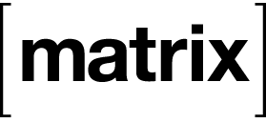
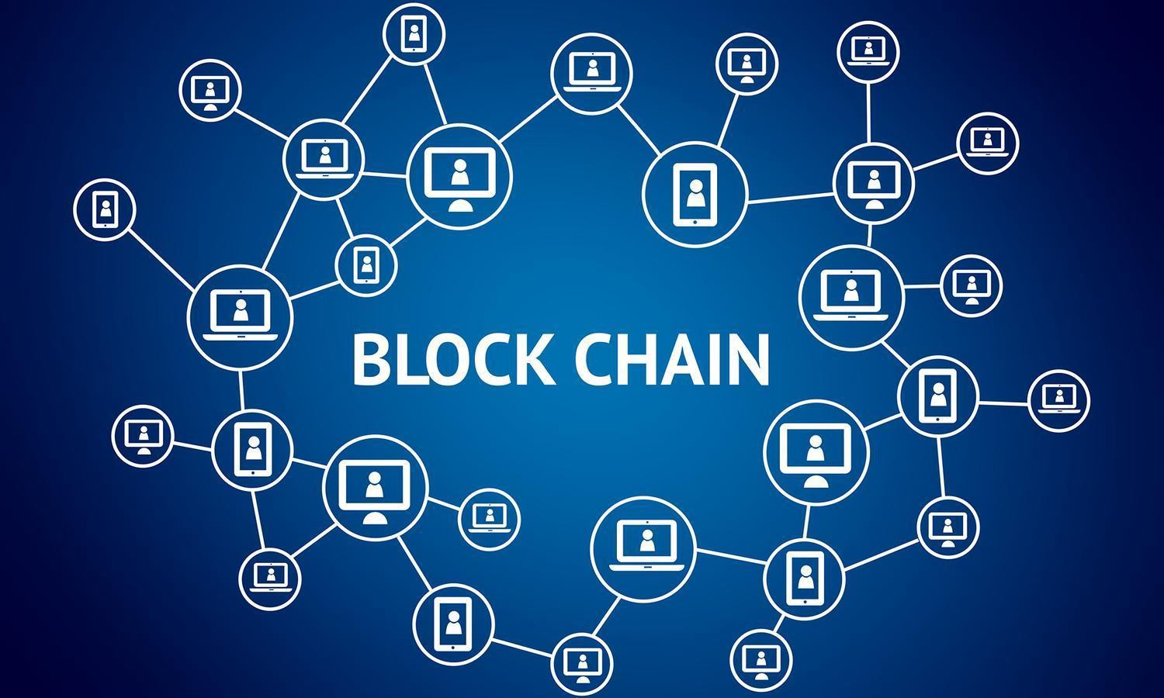
Architecture?
Matrix Topology
Blockchain Technology

Slide 10
MATRIX PROTOCOL
Matrix is an open standard for interoperable, decentralised, real-time communication over IP. It can be used to power Instant Messaging, VoIP/WebRTC signalling, Internet of Things communication - or anywhere you need a standard HTTP API for publishing and subscribing to data whilst tracking the conversation history.
Matrix defines the standard, and provides open source reference implementations of Matrix-compatible Servers, Clients, Client SDKs and Application Services to help you create new communication solutions or extend the capabilities and reach of existing ones.

Slide 11
Blockchain & Crypto-Networks
Blockchains, a distributed networking protocol shows that robust, secure infrastructure doesn’t need central authorities or servers.
Enabled by Crypto-Economic networks, a generalization of the ideas first introduced in Bitcoin and further developed in Ethereum. Cryptonetworks combine the best features of the first two internet eras: community-governed, decentralized networks with capabilities that will eventually exceed those of the most advanced centralized services.

Slide 12
Lets Discuss Applications:
TORRENTS
“Peer – Peer communication system using Peers as Seeders and also Clients.”
BLOCKSTACK
“A platform for Decentralized Internet Apps developed by a startup of the same name.”

Slide 13
Some More Apps:
Storj
“An alternative to Google Photos, where images are chopped up, encrypted, and distributed among a network of computers owned by a Community. ”
IPFS – InterPlanetary File System
“Distributed Content Delivery System saves bandwidth and prevents DDoS attacks, which HTTP struggles with.”

Slide 14
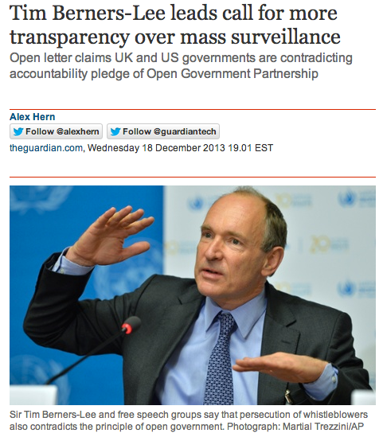
Look who’s supporting it!
Tim Berners Lee, The Creator of the World Wide Web (WWW) is now working on a SOLID project.
SOLID (derived from "social linked data") is a proposed set of conventions and tools for building decentralized Web applications based on Linked Data principles. Solid is modular and extensible. It relies as much as possible on existing W3C standards and protocols.

Slide 15
Demerits:
Design OverHead.
Security Risks.
Impossible to Reverse-Fraud.
No place for Government Regulation

Slide 16
Thank You
Rahul Jain
rjain.rahul5@gmail.com

